Slide 1
A curricular Approach to student staff training
Presented by:
Christina Gilmore, Assistant Director for Residence Life at Texas Tech University
Alisha Severson, Assistant Director of Residential Life at Purdue University

Slide 2
Learning outcomes
Identify
Participants will identify an effective way to create a student staff training utilizing a curricular approach by viewing steps, missteps and processes in student staff training at Purdue University.
Explore
Participants will explore ways to scaffold learning in student staff training by looking at examples in planning crisis and residential curriculum training for student staff.
Examine
Participants will examine effective strategies for planning student staff training by utilizing sample timelines and assessment methods.

Slide 3


Introduction
Purdue University Residential Life Background
Currently have 14,000+ residing on campus
340 Resident Assistants
22 Residential Education Assistants (Sr. RA's)
20 Residential Education Coordinators (master's level live-in staff)
5 neighborhoods with Assistant Director of Residential Life leading each
Entering 4th year with residential curriculum

Slide 4
Background of Training
Fall of 2015: Training decentralized
Fall of 2016: Training centralized with some learning outcomes
Fall of 2017: Curricular approach implemented

Slide 5

A curricular approach
Our definition: A way of designing training so that all content ties into one another and is scaffolded in a way that continually builds upon learning. Sessions are tied back to learning outcomes and learning goals.

Slide 6
Narrowing our focus: Learning Goals
Connection
Community by Peter Block
Self-authorship
Theory of Self-Authorship by Baxter Magolda
Intellectual Curiosity
The Learning Paradigm College by John Tagg

Slide 7
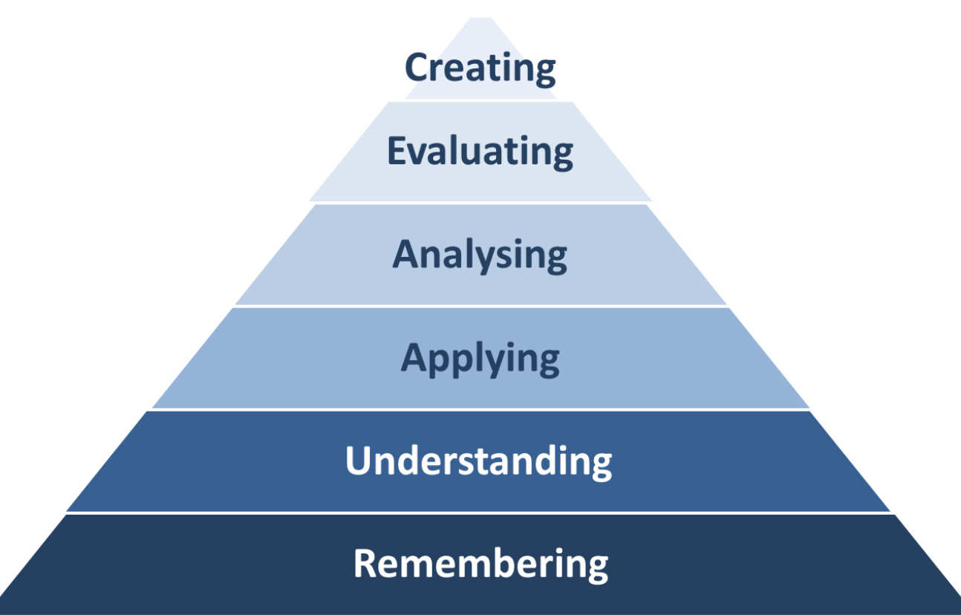
Scaffolding
Crisis
Know reporting responsibility (webcert)
Read the policy
In-person review of policies
Duty 101
Mock round experience at hall level
Open door experience
Behind Closed Doors
Call up Training (assessment model)

Slide 8
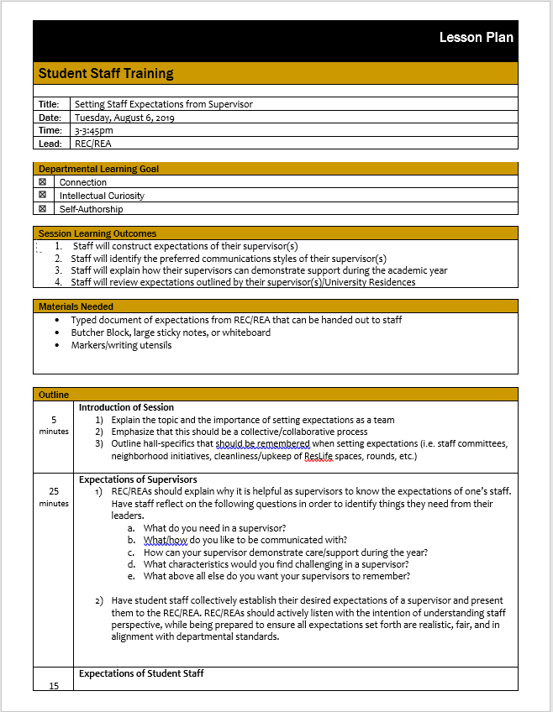
Lesson Plans
Lesson Plan Process
Discussion of topics, if they fit into learning goals, if not—does it need to be included and why?
Create / edit Learning Outcomes
Train committee members on lesson plans
Once topics are decided, lesson plans are parceled out to committee members
Review lesson plans as a committee
Focus on flipped classroom/activity based as much as possible. Keep in mind multiple learning styles & setting.
Review with fresh eyes as able

Slide 9
Training the trainers
Training sessions with professional staff on training in July
Presentation templates
Day by day guides
References in lesson plans
Autonomy vs. Consistency

Slide 10
Steps and Missteps
Steps
Consistency in content creators for different areas (example crisis)
Took our time in planning/creating lesson plans
Lesson plan creation
Critically review lesson plans each year
Professional staff training aligning with student staff training (including binders)
Incorporated professional staff readings and research into student staff training
Committee makeup
Addition of day by day guides
Missteps
Using LOs rather than goals
Failed to be intentional with scaffolding throughout
Did not scaffold between the trainings (student staff vs. Full time)
During transition of staff, content disappeared and had to start from scratch.
Lack of training of REC's on the committee
Communicating the importance of following lesson plans to professional staff.
Communication in general about the execution of training

Slide 11
Assessment
Use multiple methods throughout training
Group quizzes on items like purchasing
Test your training knowledge neighborhood trivia midway through
Incident Report writing practice and review with supervisor
Call up training online assessment
Assess overall learning two weeks into academic year

Slide 12
January training
Scaled down version (2 days)
Conference-style sessions led by student and professional staff
All sessions must fall under one of our three learning goals
Typically offer around 35 session options split into three, 50-minute blocks

Slide 13
Timeline for content creation
First week of classes (last week in August): "Wrap Up and App Up" with previous year committee
First week in September: Meet with new committee members, discuss timeline and look at assessment data and schedule from previous year's winter training; review any goals passed down from Director/Provost/President and general committee goals and expectations
Second week in September: Create first draft of learning outcomes and schedule
Third week in September: Finalize outcomes and schedule and divide up tasks, lesson plan writing training
Fourth week in September: Task time, no meeting
October—task check-ins and dividing up more tasks as we go. Winter training materials typically finalized by third week in October with information being sent out to supervisors and call for programs.
Last week in October/first week in November: review Fall training data
November: Review previous year's learning outcomes and tweak based on data received, create new as needed
December: Finalize any program sessions and presenters for Winter training
January: Debrief winter training, do SWOT analysis as needed, Fall training learning outcomes continue, start building the schedule
End of January: First draft of Fall training created; tasks divided
End of February: All in-hall lesson plans completed, final draft of full schedule sent to leadership team
Beginning of April: All training sessions finalized, start reaching out to presenters
After closing through mid-June: Final preparations for Fall training including day by day guides, and training presentations for professional staff training

Slide 14
Questions? Best Practices to Share?
Christina Gilmore
  Christina.gilmore@ttu.edu
Alisha Severson
  Seversoa@purdue.edu

