Slide 1
Time Spent on Hiring is Time Well Spent
Curricularizing Student Staff Selection
Presented by Kayla Reed and
Molli Keller from Purdue University

Slide 2
Learning Objectives
Attendees will connect the 10 Essential Elements of Curriculum to the student staff selection process.
Attendees will create at least one potential learning outcome for their student staff selection process.
Attendees will be able to create their own curricular approach to student staff selection that is relevant to their institution.

Slide 3

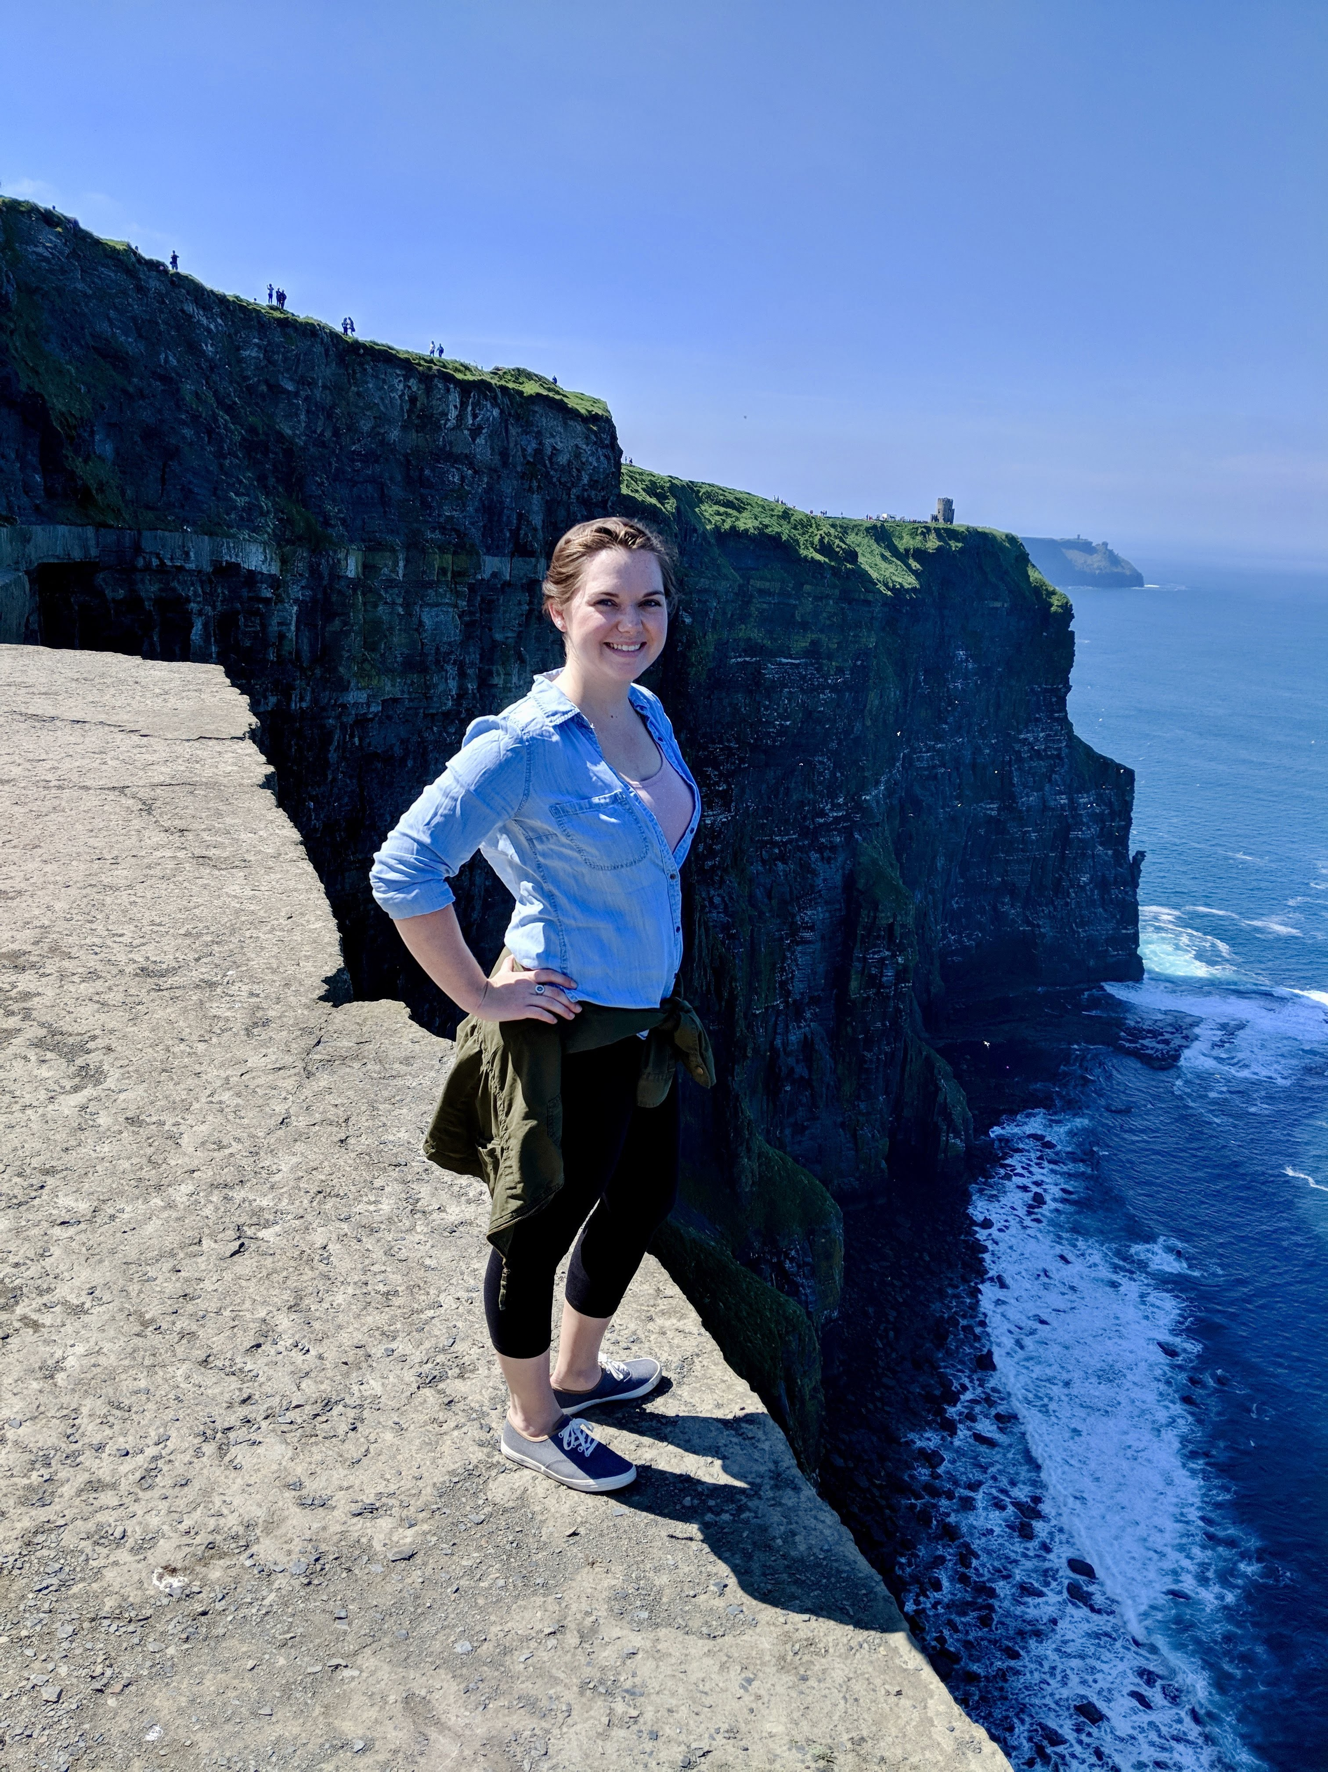

Introduction of Presenters
Molli Keller
Kayla Reed
Residence Education Coordinator
Residential Learning Specialist

Slide 4
Permission Granted
Steps we took to overhaul our process:
Spoke with the Student Staff Recruitment committee
Worked with Human Resources to update the job description of the student staff role to align with learning goals
Developed questions and rubrics for the process that incorporated the updated job description

Slide 5
Connecting Student Staff Selection to the 10 Essential Elements

Slide 6
Directly Connects to Institutional Mission
Learning Goals and Outcomes Developed and Based in a Defined Educational Priority
Basis in Development Theory and Research
Educational Strategies Are Developed to Advance Learning Outcomes
Educational Strategies Go Beyond Programmed Events
Student Staff Are Utilized in Roles Appropriate to Their Skill Development
Learning is Scaffolded and Sequenced to Follow Time-Based Development
Key Stakeholders Are Identified and Involved
Peer-review is Accomplished Through an Intentional Process
Assessment Occurs at All Levels: From Educational Priority to Learning Goals and Outcomes

Slide 7
Activity
Using your worksheet, develop 1-3 potential learning outcomes for your student staff selection process.
Things to consider:
  Who is your audience?
  What do you want the audience to get out of the student staff selection process?
  Think about the different parts of your interview process (ie. Individual interview, group process, etc.).

Slide 8
Directly Connects to Institutional Mission
Learning Goals and Outcomes Developed and Based in a Defined Educational Priority
Basis in Development Theory and Research
Educational Strategies Are Developed to Advance Learning Outcomes
Educational Strategies Go Beyond Programmed Events
Student Staff Are Utilized in Roles Appropriate to Their Skill Development
Learning is Scaffolded and Sequenced to Follow Time-Based Development
Key Stakeholders Are Identified and Involved
Peer-review is Accomplished Through an Intentional Process
Assessment Occurs at All Levels: From Educational Priority to Learning Goals and Outcomes

Slide 9
Activity
Brainstorm educational strategies that can be used in a student staff selection process.
  Examples: Essays, Individual Interviews, Group Process

Slide 10
Directly Connects to Institutional Mission
Learning Goals and Outcomes Developed and Based in a Defined Educational Priority
Basis in Development Theory and Research
Educational Strategies Are Developed to Advance Learning Outcomes
Educational Strategies Go Beyond Programmed Events
Student Staff Are Utilized in Roles Appropriate to Their Skill Development
Learning is Scaffolded and Sequenced to Follow Time-Based Development
Key Stakeholders Are Identified and Involved
Peer-review is Accomplished Through an Intentional Process
Assessment Occurs at All Levels: From Educational Priority to Learning Goals and Outcomes

Slide 11
Activity
Brainstorm stakeholders on your campus that you would want to have involved in the development and selection process.
  Examples: Faculty Fellows, Committee Chairs, Other ResLife Initiatives (Training Committee)

Slide 12
Directly Connects to Institutional Mission
Learning Goals and Outcomes Developed and Based in a Defined Educational Priority
Basis in Development Theory and Research
Educational Strategies Are Developed to Advance Learning Outcomes
Educational Strategies Go Beyond Programmed Events
Student Staff Are Utilized in Roles Appropriate to Their Skill Development
Learning is Scaffolded and Sequenced to Follow Time-Based Development
Key Stakeholders Are Identified and Involved
Peer-review is Accomplished Through an Intentional Process
Assessment Occurs at All Levels: From Educational Priority to Learning Goals and Outcomes

Slide 13
Questions?

Slide 14
Thank You.

Slide 15
References
http://www.myacpa.org/events/ica

